Slide 1
THE LEGION
Abhinav Kumar | 2020 | VIT University ,vellore
Siddharth Shah | 2020 | VIT University ,vellore
Tirush K Dixit | 2020 | VIT University ,vellore

Slide 2

About us
We all have completed our Btech from VIT university in computer science.
Young Technological enthusiasts strive to bring a change and do our part in the time of crisis.
Motivated by the challenges we all gathered in a team for the first time for a hackathon.
Our linkedIn profiles-
https://www.linkedin.com/in/abhinav-kumar-81491b1a0
https://www.linkedin.com/in/siddharth-shah-957a111a9
https://www.linkedin.com/in/tirush-k-dixit-a72b4a18a

Slide 3
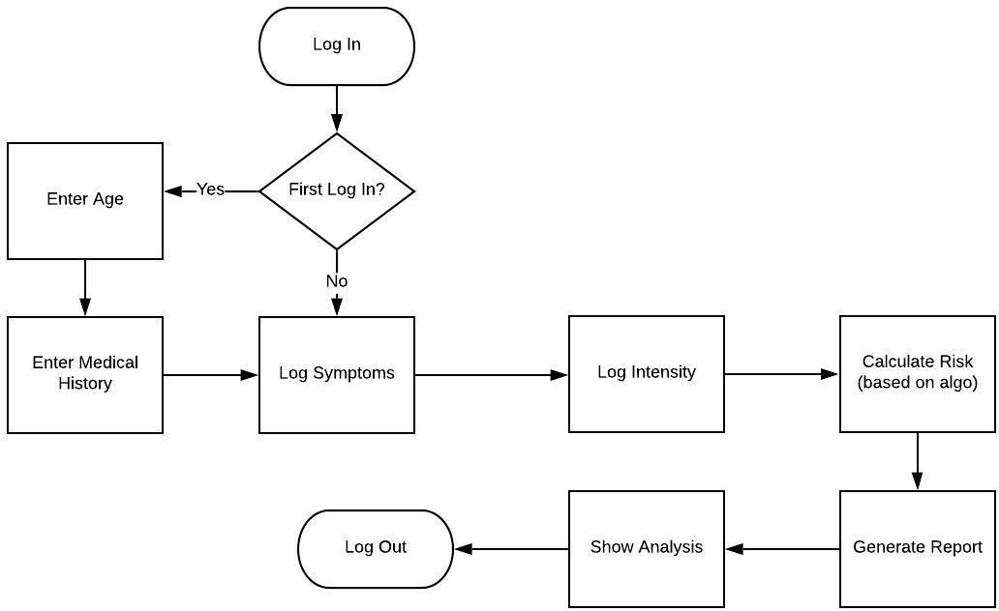
Problem Statement
Process Flow-
-
A module to log, track and share the daily symptoms of a corona patient or a suspected corona patient during the quarantine. The user can log in his symptoms daily and if the they are worsening or more symptoms of Corona are showing up, it will be escalated to the care provider. User will be able to view his symptom progression trends and share the same with doctor.
Process flow link - https://drive.google.com/open?id=1HcM88-g4j6ePtMKwQ1LAvkjyBG4Mo-xx

Slide 4
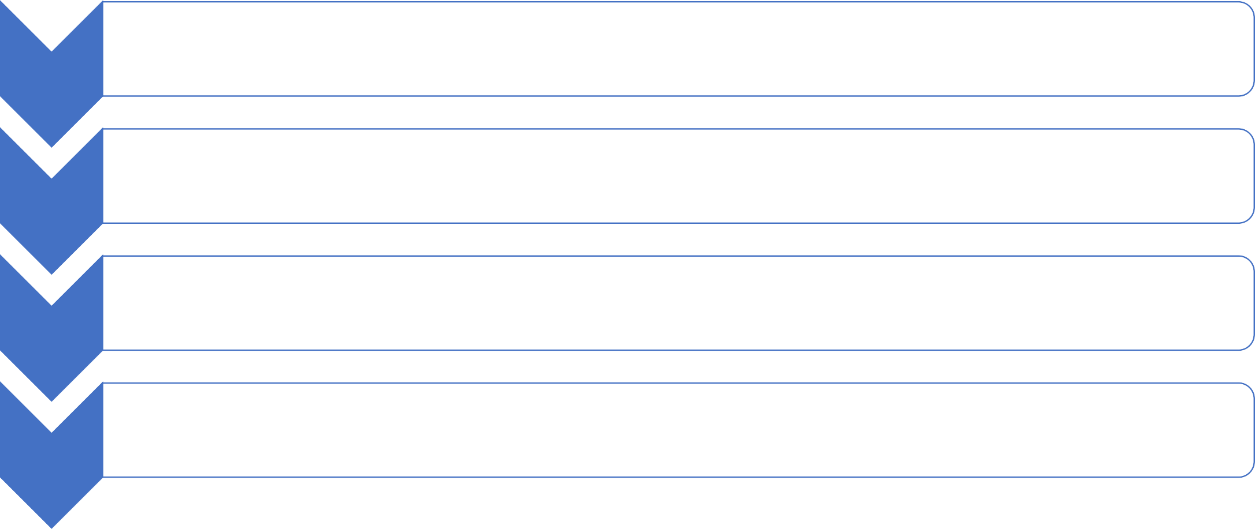
Tech Stack- Mean stack
Angular JS
FRONTEND
Node JS
BACKEND
Heruko for deployment
Cloud Service Providers
MongoDB
DataBase

Slide 5
Our solution-
We were able to derive a new algorithm that significantly produces the result at a good precision rate.
Generic method to calculate risk based on multiple factors:
Type of symptom (serious, common and rare)
Intensity
Number of days
Age group
Medical Conditions
Flexible solution to accommodate future enhancements . Risk-values associated with factors can be easily changed based on data and feedback.
Detailed report of symptoms and risks including graphs.
We use our custom designed flowchart, risk values and risk scale to track user symptoms.

Slide 6
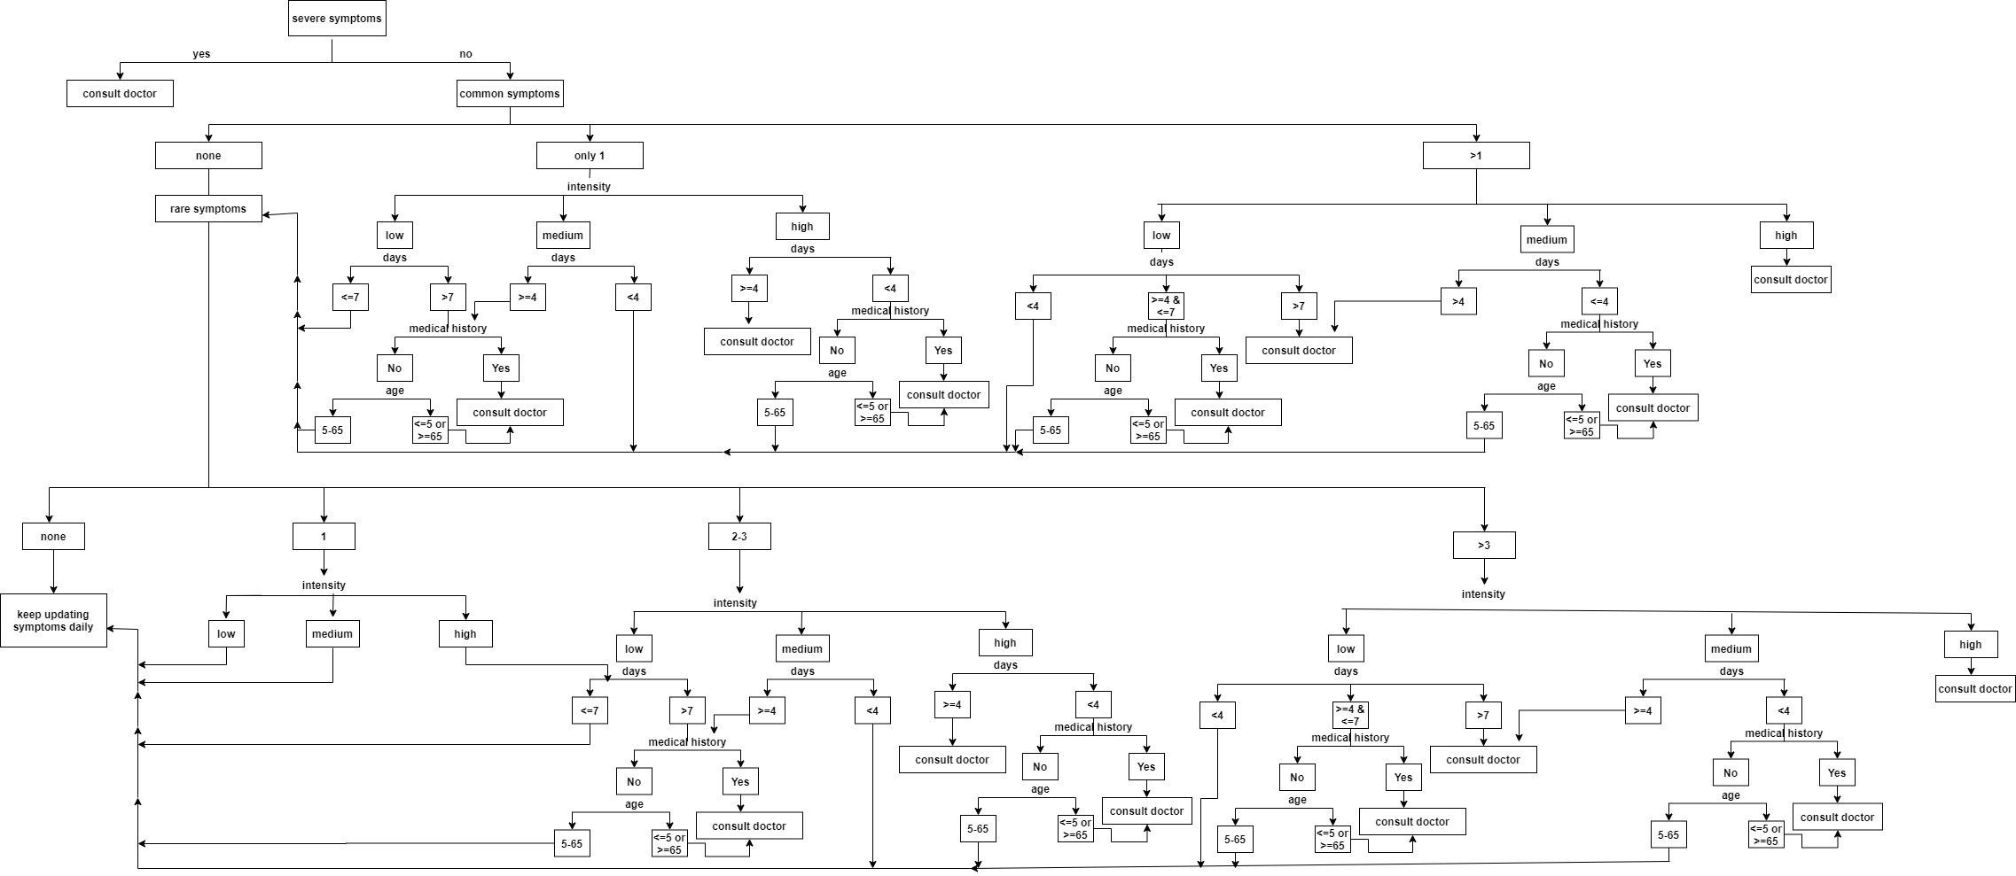
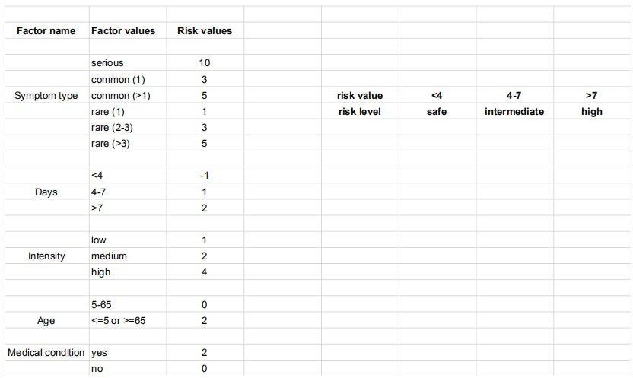

Tracker flowchart-
Risk values and scale-
https://drive.google.com/open?id=1sq-XFQIeAxjzrelPmlS4FVUS4wsQ4dhV
https://drive.google.com/open?id=1df2TaCdWEPmoQdBT9KI_RNjRws55_-Ts

Slide 7
Future possible enhancements
After accumulation of sufficient data and feedback, we can adjust risk-values associated with different factors to increase accuracy.
Once we have enough data accumulated, we can use machine learning models to determine the risk values associated with different factors.
In later versions, we can have additional features such as virtual doctors appointment, corona symptoms chatbot.
We can add ask user for recent travel details and map that against conainment zones list to add one more risk factor.

Slide 8
Challenges faced-
Symptom log- what happens if the user logs data more than once during the same day.
sSymptom log- what if user do not log symptoms daily or skips the log for a day.
Saving days data- what if user says he do not have fever but then comes back and updates that he has fever.
Generalising the solution so as to accomodate any new factors.

Slide 9
Differentiating factors-
We track complete history of user and not just one time check(like many other corona tracker).
Detailed info related to users medical history and symptom data is provided on the profile section.
We provide user with complete guidelines about whatever actions need to be taken.
Our solution can easily accomodate any changes in groud rules for existing factors for addition of a new factor.

Slide 10
Risks/ Challenges
Enabling users to log symptoms daily.
Associating accurate risk-values to each factor.
References
WHO- https://www.who.int/emergencies/diseases/novel-coronavirus-2019
worldometer- https://www.worldometers.info/coronavirus/coronavirus-symptoms/
MOHFW- https://www.mohfw.gov.in/

